Slide 1
Network Authenticated Assembly
Infosys Ltd., British Telecom, Telstra
Contacts:
abhisek.das04@infosys.com, bishnu_panda@infosys.com
pawan.7.kumar@bt.com, shyamtanu.banerjee@team.telstra.com;

Slide 2
Contents
Background
Sample implementation
High level description
NAA API Family
Sequence Diagram
User story
Deliverables Status
Double click on open pointers

Slide 3
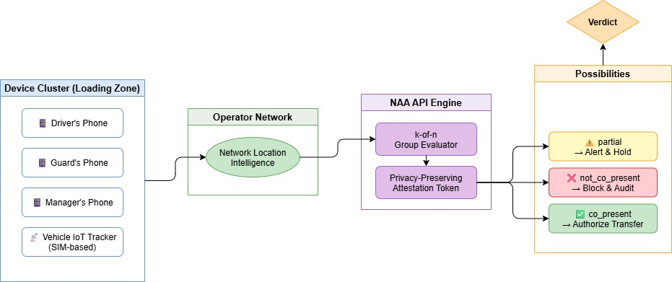
Background- Network‑Authenticated Assembly
API benefit
Verify a group of SIM/eSIM devices are physically co-located — in a single API call, no coordinates exposed to caller
k-of-n group verdict — co_present / partial / not_co_present — configurable minimum threshold per cluster
Signed attestation token — act on trusted presence without revealing any individual device position
Two modes: on-demand POST /verify and continuous POST /assembly-subscriptions
Zero new operator capability required — composes existing network location intelligence server-side
New business scenarios driven：
NAA enables trust automation for physical multi-party workflows in Banking (cash-in-transit), Logistics, Field Services, Healthcare, and Controlled-Access Infrastructure — anywhere people, devices, and assets must be confirmed together before a sensitive action is authorized

Slide 4
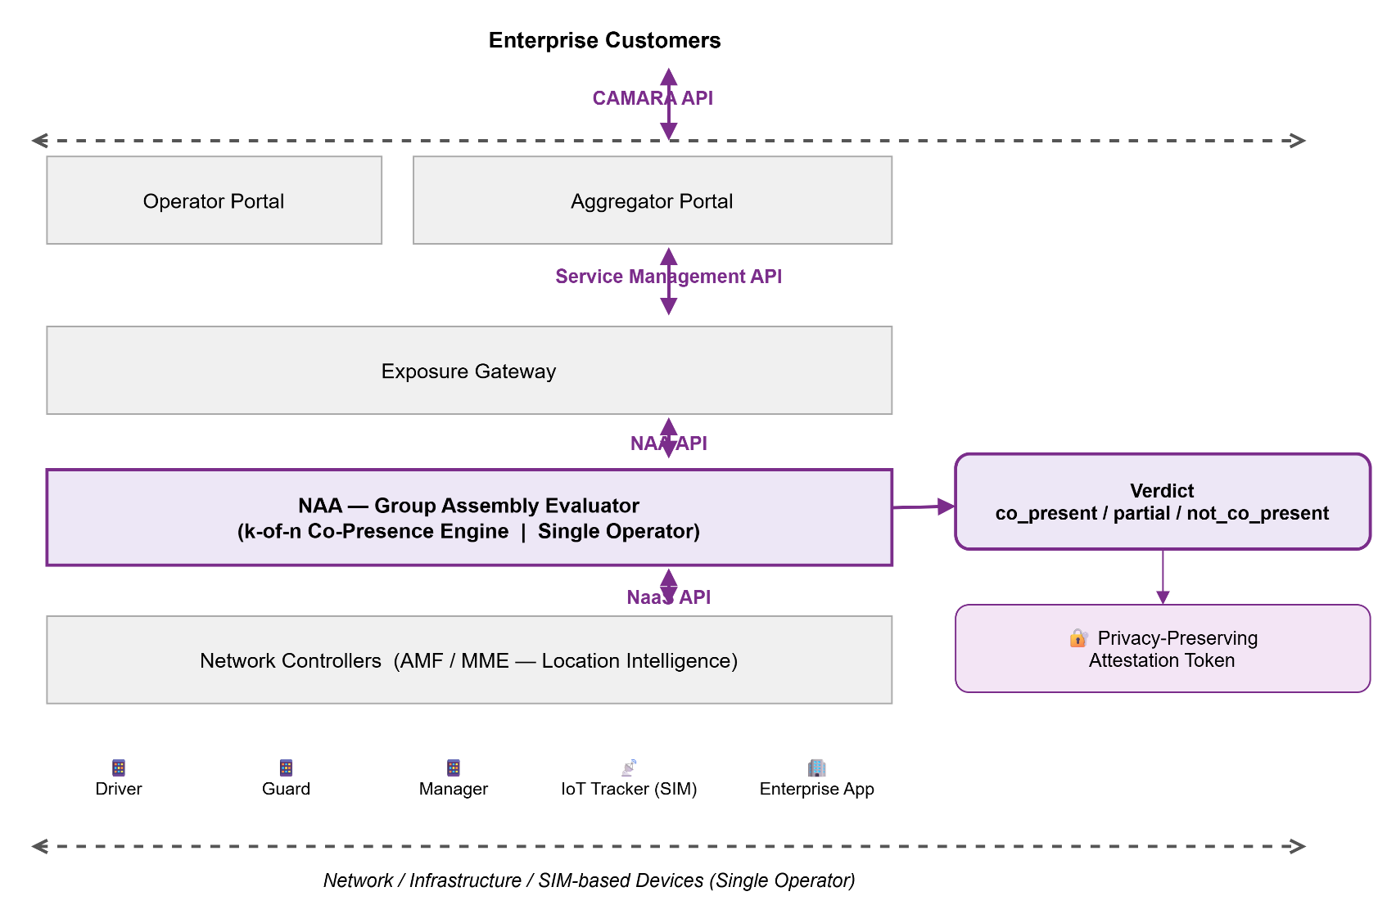
Sample implementation: Network Authenticated Assembly

Slide 5
NAA API: High level description
NAA verifies that a defined group of SIM-based devices are physically co-located within a zone and time window — returning a single group verdict (co_present / partial / not_co_present) with a privacy-preserving attestation token. The caller never sees any device location.
Key points:
Single API call for N devices — no per-device location results
k-of-n threshold logic — partial presence is a first-class outcome
On-demand (POST /verify) + subscription-based continuous monitoring
Restricted to operator-addressable devices (SIM/eSIM only)
Targets Banking, Logistics, Field Services, and Healthcare workflows
Not a DeviceLocation enhancement — it answers "are these devices together?", not "where is this device?" — a distinction that preserves privacy and makes the group verdict architecturally unique.

Slide 6
NAA API family
API Name | API Function | Method
NAA Assessment | For a given device cluster and zone parameters, check network ability to resolve co-presence for all specified SIM-based devices | POST
NAA Verify | Submit a device cluster for co-presence verification. Returns group verdict (co_present / partial / not_co_present) and a signed privacy-preserving attestation token. Supports: a. cluster size (k-of-n threshold) b. zone definition and time window tolerance | POST
NAA Subscription Creation | Create a continuous co-presence monitoring subscription for a device cluster. Triggers webhook events on verdict change (status-changed CloudEvent). Supports: a. subscriptionExpireTime b. subscriptionMaxEvents | POST
NAA Subscription Query | Query an existing co-presence subscription and its current status | GET
NAA Subscription Modification | Modify an active subscription — update time window, k-of-n threshold, or expiry | PATCH
NAA Subscription Deletion | Delete an active co-presence subscription and stop monitoring | DELETE

Slide 7
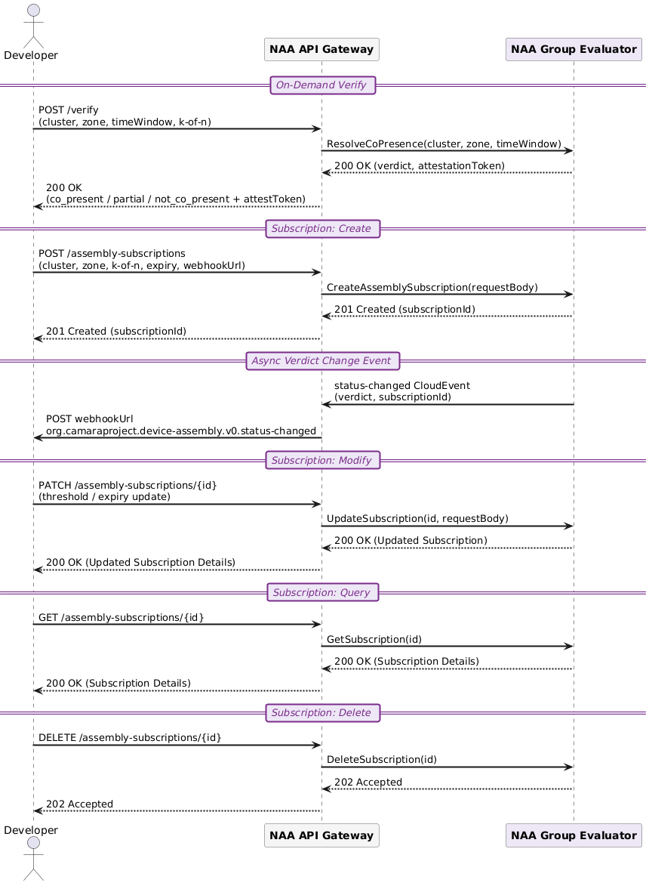
Sequence Diagram

Slide 8
User story
Item | Details
Summary | As an application developer or enterprise customer, I want to verify (using my application server/backend service) that a defined group of SIM-based devices are physically co-located within a specific zone and time window — so that I can automate trust decisions for security-sensitive physical workflows without exposing any device location to my application.
Roles, Actors and Scope | Roles: Enterprise Customer Actors: Application developers, enterprise security teams, industry customers (banking, logistics, field services, healthcare) Scope: On-demand co-presence verification (POST /verify) — Submit device cluster, get group verdict + attestation token Subscription-based continuous monitoring (POST /assembly-subscriptions) — Create / Query / Modify / Delete a monitored cluster subscription with webhook-based verdict change notifications
Activities / Steps | Starts when: The customer application server makes a POST /verify request (including device cluster identifiers, zone definition, time window tolerance, and k-of-n threshold) to the NAA API, triggering operator-side co-presence resolution across all specified SIM/eSIM devices. Returns: A group verdict (co_present / partial / not_co_present) and a signed privacy-preserving attestation token. No individual device location is returned to the callerFor subscriptions — Ends when: The customer application server makes a DELETE /assembly-subscriptions/{id} request, or the subscription expires automatically when subscriptionExpireTime is reached or subscriptionMaxEvents is exhausted.

Slide 9
API Deliverables status
Deliverable Required/Optional (R/O) Current status
API Specs | R | In Progress
API documentation | R | TBD
User stories | R | Available
Test cases | R | TBD
Implementation | O | TBD

Slide 10
Appendix

Slide 11
NAA Vs Device Locations
NAA is a New Abstraction Layer, Not a Device Location Enhancement
Caller supplies zero coordinates — no lat/lon input, no zone exposed to the caller
Output is a relational group verdict (co_present / partial / not_co_present), not a location value
Privacy-preserving by design: individual positions are never returned, even partially
Promoting it as a DeviceLocation enhancement would force callers to aggregate individual location results — increasing privacy surface and destroying the attestation model
 | Device Location Verification | NAA
Input | 1 device + caller lat/lon | N devices, no coordinates
Output | Location boolean | Group relational verdict
Privacy | Caller knows the zone | Caller learns nothing about position
The group verdict cannot be cleanly expressed as a DeviceLocation enhancement without breaking the core privacy guarantee — that is the architectural justification for a separate API family

Slide 12
Device Eligibility: Operator-Addressable Only
Cluster members restricted to SIM/eSIM identities — same schema as existing CAMARA APIs
Key Points:
Tags, beacons, gateways, and carts are removed from the proposal
All cluster members must use CAMARA-standard device identifiers:
phoneNumber (E.164)
networkAccessIdentifier
ipv4Address / ipv6Address
IoT trackers in scope only when SIM/eSIM-based (e.g. the armored vehicle tracker = cellular module with a phone number)
Non-operator-visible trackers (Bluetooth, Zigbee, LoRa) → explicitly out of scope, documented in spec
Every cluster member is independently verifiable by the operator using existing network-layer
No new operator capability required. This change directly resolves the interoperability concern.

Slide 13
Continuous Checks: Full CAMARA Subscription Model
"Continuous at scale" scoped as a proper subscription resource — aligned with Geofencing Subscriptions pattern
The subscription model is structurally identical to Geofencing Subscriptions — reviewers familiar with that API will find the pattern immediately recognizable

Slide 14
Questions posted on PR
Q1: Overlap — why not just enhance DeviceLocation? DeviceLocation evaluates one device at a time. NAA's atomic server-side group verdict (k-of-n across N devices) cannot be reproduced by calling DeviceLocation N times client-side — because the group verdict must be atomic, consistent across all devices at the same moment. Client-side aggregation breaks atomicity (race conditions, partial failures) and cannot produce a single signed attestation token. The delta is architectural, not just a feature flag.
Q2: Weak differentiation vs Location Verification? The normative gap: Location Verification returns a per-device boolean. NAA returns a relational group verdict with a k-of-n threshold enforced server-side. Standardizing this server-side is required for interoperability because:
the aggregation logic must be identical across operators
the attestation token must be verifiable by a relying party without re-querying individual devices, and
partial-presence states (partial) have no equivalent in Location Verification semantics.
Q3: Consent / privacy model underspecified? Two explicit modes:
Enterprise fleet : All devices are operator-registered assets under a single enterprise tenant. No end-user consent needed beyond enterprise subscription agreement.
Multi-user cluster: Each device owner must grant explicit OAuth scope consent. NAA returns only the group verdict — no individual coordinates, no identity linkage exposed via API. Data minimization: raw locations never leave the operator; only the boolean verdict + attestation token are surfaced.
Q4: Subscription model too vague? [To be discussed during Spec development] Subscription resource model (aligned with Geofencing Subscriptions pattern):
POST /assembly-subscriptions → creates subscription, returns subscriptionId
Event types: assembly.co_present, assembly.partial, assembly.not_co_present
Payload: CloudEvent envelope with subscriptionId, verdict, timestamp, attestationToken
Callback: HTTPS webhook; retries per CAMARA notification guidelines
Expiry/cancellation: maxDuration field + DELETE /assembly-subscriptions/{id}
Lifecycle states: ACTIVE → EXPIRED / DELETED

